Slide 1
GeoJSON
Pandas will read geoJSON files but changes the format.
It is much easier to manipulate geojson with libraries like geopands, which creates geoDFs that can be manipulated.
The geojson library has features which allow the convenient creation of geojson feature groups.

Slide 2
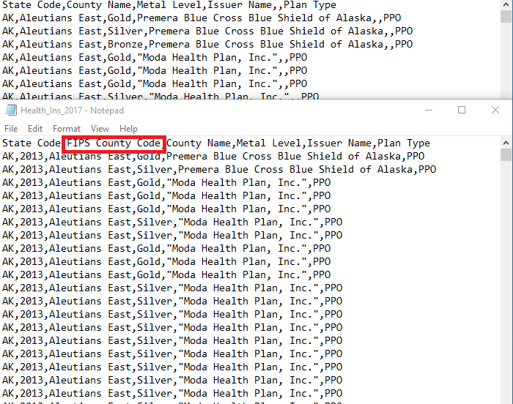
Inconsistent Data
The data we used had inconsistent data across years. We committed to using this data set without realizing how poor it was for years before 2016.
Incorrect spellings and missing data made it difficult to manipulate the data for some years.

